Slide 1
Seeing is Believing?
Detecting Authentic Images in the Age of Generative AI

Slide 2
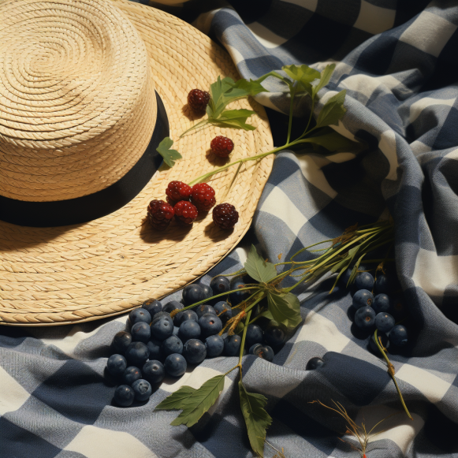


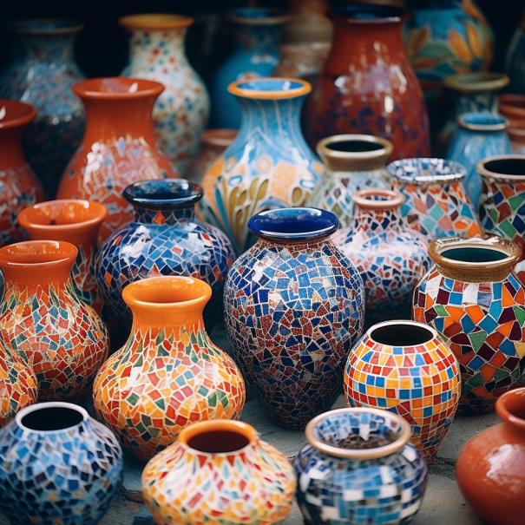
Problem Statement
AI generated images can be challenging to distinguish from authentic photographs. Without some method to detect synthetic images, generative AI may become a misinformation risk (i.e., deep fakes). Are there underlying patterns produced by diffusion models that can be learned by a classifier to predict whether an image is real or fake?

Slide 3
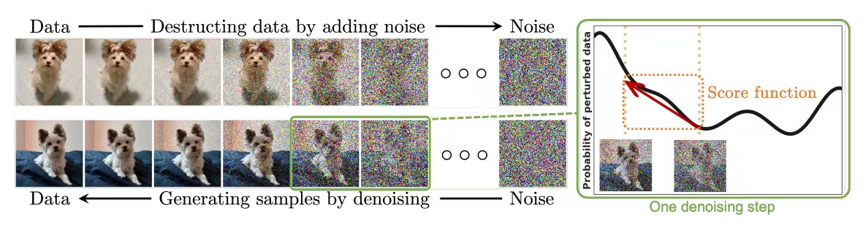
Diffusion Models
How do diffusion models work?
- Take input images and add noise; train the model on the transformations to add noise
- Reverse diffusion takes what’s learned from the transformations to reverse the noise and end with an image
- Hypothesis: Some “residual noise” remains after the reverse diffusion that is undetectable to the human eye but recognizable by an ML algorithm

Slide 4
Two Approaches
1). White Box Approach: Train a family of classifiers on pixel intensity to determine if the distribution of authentic images is discernably different from generated images
- Process images into RGB color channels
- Find the intensity of each image pixel (continuous value between 0 and 255)
- Train a set of classifiers on a dimensionally reduced dataset (PCA) of the full pixel vector
2). Black Box Approach: Train a Convolutional Neural Networks to learn patterns among the features it extracts
- Validate multiple architectures to determine which performs best
- Take the best performing architecture and train across various number of epochs
- In both approaches, the goal is to match the SOTA benchmark of 92.98% as close as possible (near-future SOTA +99%?) and generalized to out-of-distribution images

Slide 5
The Datasets
CIFAR-10 (Real Images)
- A dataset of 60,000 images in 10 classes (6,000 images per class)
- 50,000 training images / 10,000 test images
- Standardized 32x32 color images
- Classes include airplane, automobile, bird, cat, deer, dog, frog, horse, ship, truck
- Classes are mutually exclusive with no overlap between categories
CIFAKE (AI-Generated Images)
- A dataset of 60,000 images in 10 classes (6,000 images per class)
- 50,000 training images / 10,000 test images
- Standardized 32x32 color images
- Same classes as CIFAR-10
- Generated via SDM², an open-source Latent Diffusion Model

Slide 6
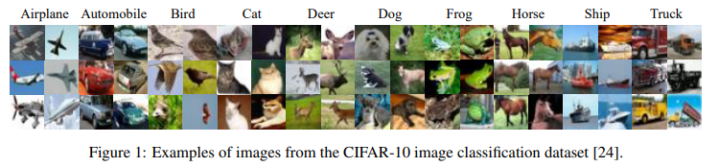

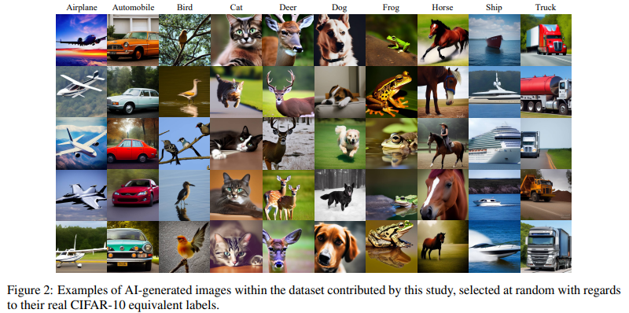

Slide 7
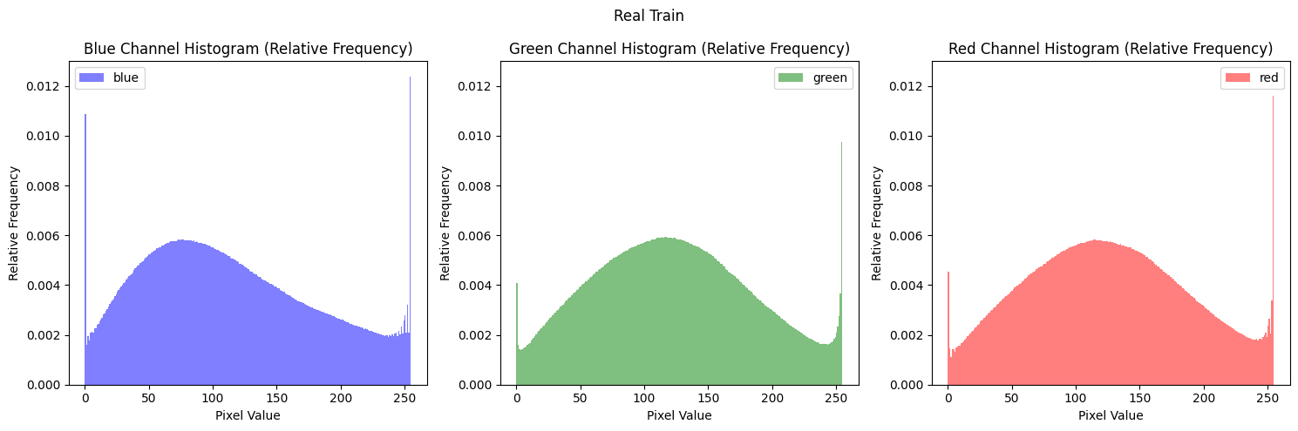
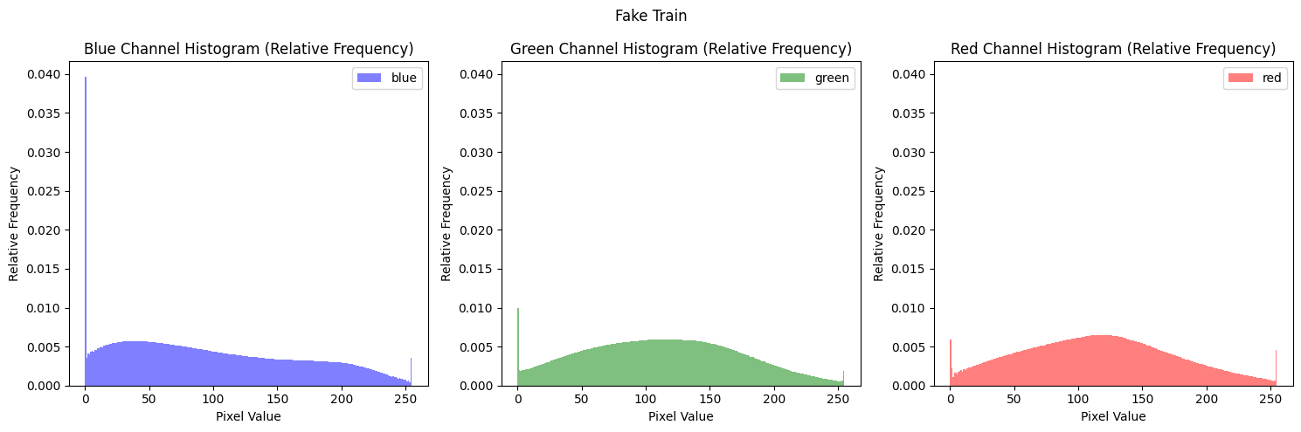
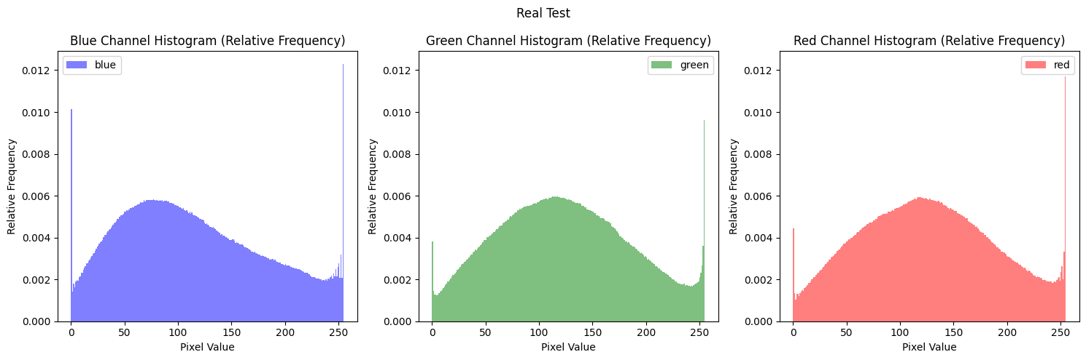
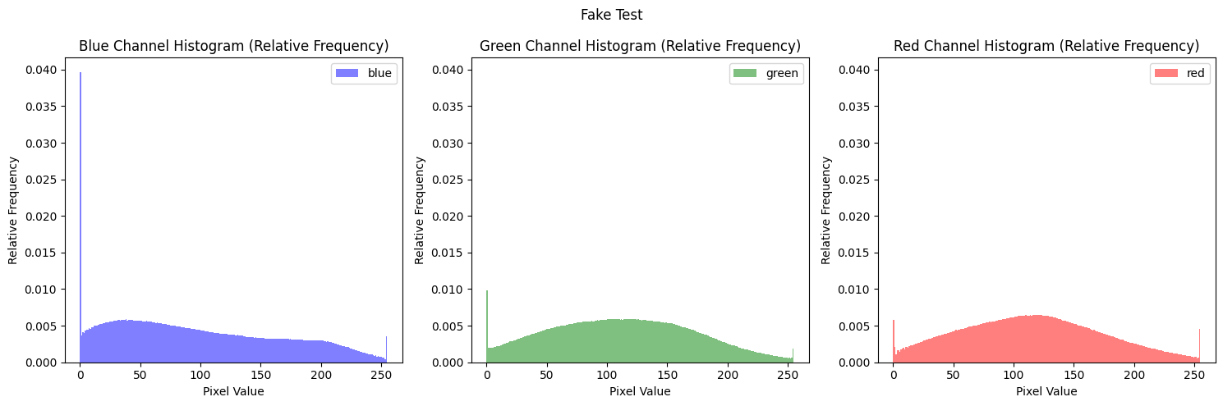
Exploratory Data Analysis
The average pixel intensity across classes has a distinctly different distribution from its opposite, observable in both train and test sets

Slide 8
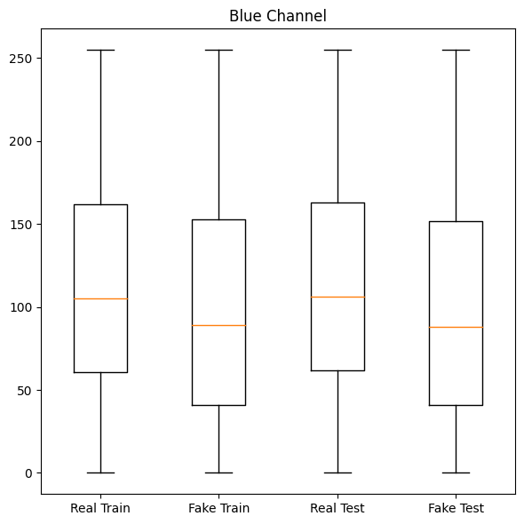
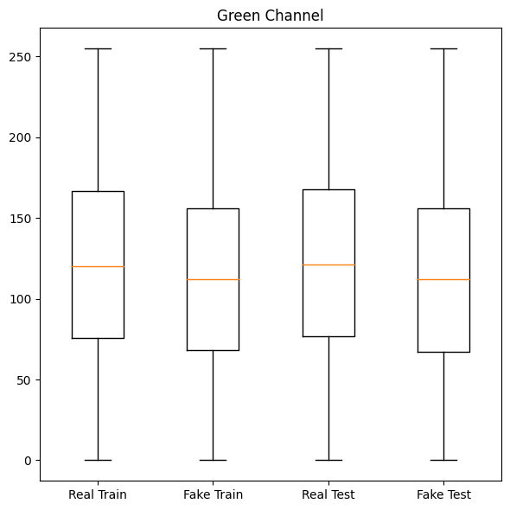
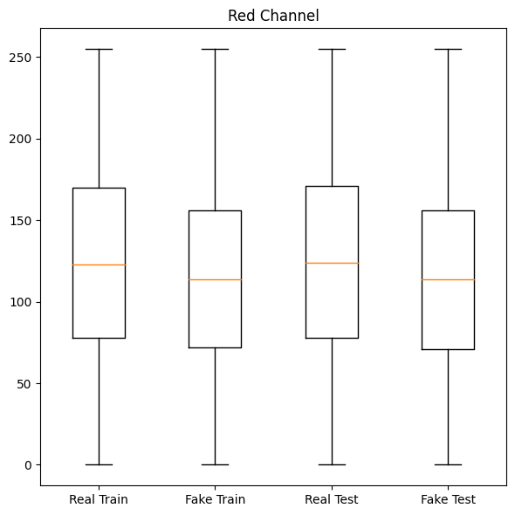
Exploratory Data Analysis
Across all color channels, the real images have a higher median pixel intensity and IQR, demonstrating an observable difference in the distribution among classes

Slide 9
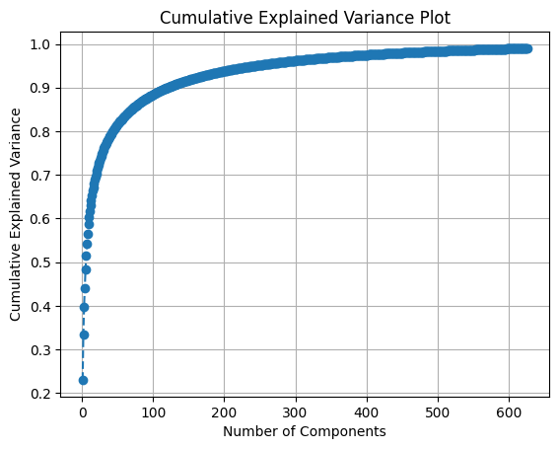
White Box Approach
- 3,072 pixels per image (32x32x3)
- PCA resulted in 120 components with 90% of the explained variance ratio
- Training time was ~1/3 of the 99% of the explained variance
- 8 Model architectures were trained and validated against this PCA dataset

Slide 10
Models in Scope
Model | Hyperparameters | Network Topology
Logistic Regression | L2 penalty, lbfgs solver, 100 iterations
Random Forest | 100 estimators, Gini impurity
Gradient Boosting Trees | 100 estimators, log loss, 0.1 LR
XGBoost | 100 estimators, max depth 6, 0.3 LR
Feed Forward MLP | Adam solver, max iter 3000, 0.001 LR | 64 | ReLU | 32 | ReLU | 1 | Sigmoid
Keras Feed Forward | Adam solver, early stopping, 0.001 LR | 64 | ReLU | DO | 32 | ReLU | 1 | Sigmoid
Wide & Deep NN | Adam solver, early stopping, 0.001 LR | 128 (64 | 64:32) | ReLU| DO | 32 | ReLU | DO | 1 | Sigmoid
TabNet | Adam solver, 0.02 LR | Feature TF (3), Attention TF (2), Dense

Slide 11
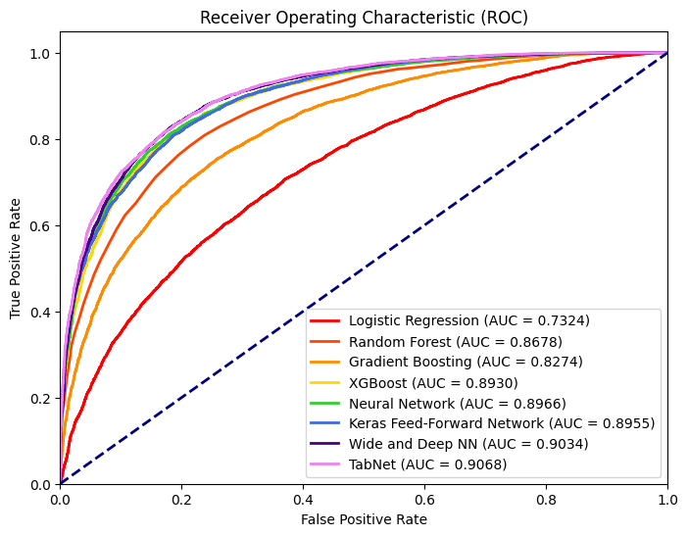
White Box Performance Report
Model | Acc. | AUC | Recall | Prec. | F1
LR | 0.6661 | 0.7324 | 0.6483 0.6838 | 0.6722 0.6604 | 0.6600 0.6719
RF | 0.7853 | 0.8678 | 0.7620 0.8086 | 0.7992 0.7726 | 0.7802 0.7902
GB | 0.7466 | 0.8274 | 0.7454 0.7486 | 0.7478 0.7462 | 0.7466 0.7474
XGB | 0.8111 | 0.8930 | 0.8138 0.8084 | 0.8094 0.8128 | 0.8116 0.8106
NN | 0.8149 | 0.8966 | 0.8154 0.8144 | 0.8146 0.8152 | 0.8150 0.8148
FF | 0.8032 | 0.8955 | 0.7270 0.8793 | 0.8576 0.7631 | 0.7869 0.8171
WD | 0.8218 | 0.9034 | 0.8127 0.8309 | 0.8278 0.8160 | 0.8202 0.8234
TN | 0.8200 | 0.9068 | 0.7955 0.8445 | 0.8365 0.8051 | 0.8155 0.8243

Slide 12
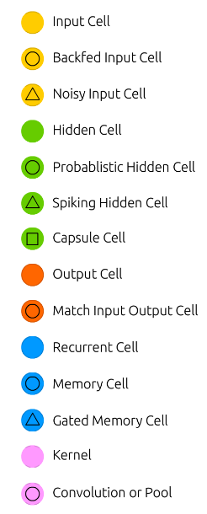
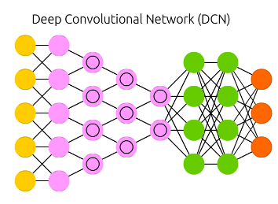
Black Box Approach
- Instantiate a CNN like the CIFAKE paper best-in-class model with some adjustments
- Benchmark experiment performance against 92.98% accuracy
- Refine architecture based on CNN heuristics (depth, activation functions, skip-connections)
- Compare best models between approaches

Slide 13
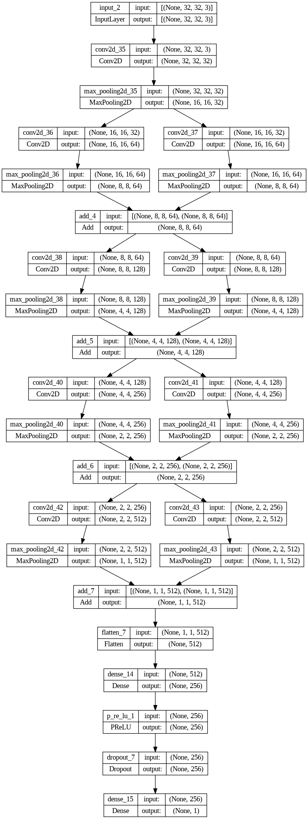
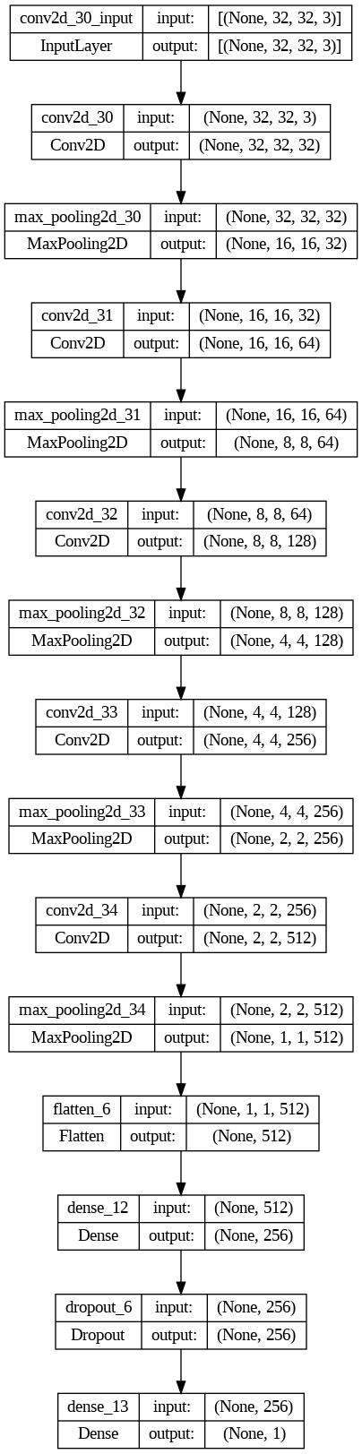
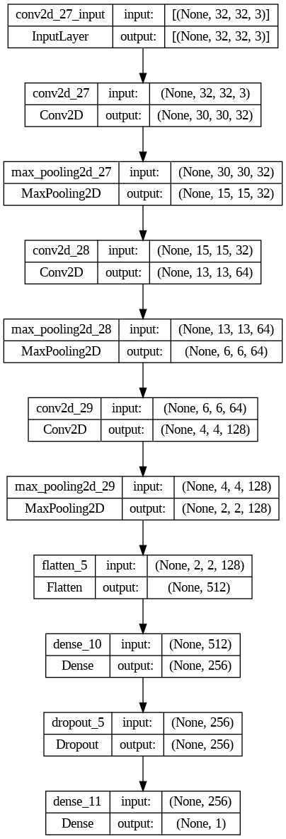
Three Model Architectures
Alpha – (3) Conv/M-P layers with a 256-unit dense layer | ReLU activation with sigmoid final
Beta – (5) Conv/M-P layers with a 256-unit dense layer | ReLU activation with sigmoid final
Gamma – (10) Conv/M-P layers with (2) channels and skip connections with a 256-unit dense layer | PReLU activation with sigmoid final
Alpha
Beta
Gamma

Slide 14
Best Model Comparison – Pt. I
Metric | Wide & Deep NN | CIFAKE Paper | Alpha | Beta | Gamma
Accuracy | 0.8218 | 0.9298 | 0.9312 | 0.9420 | 0.9484
Loss | 0.4038 | 0.1800 | 0.1947 | 0.1935 | 0.1466

Slide 15
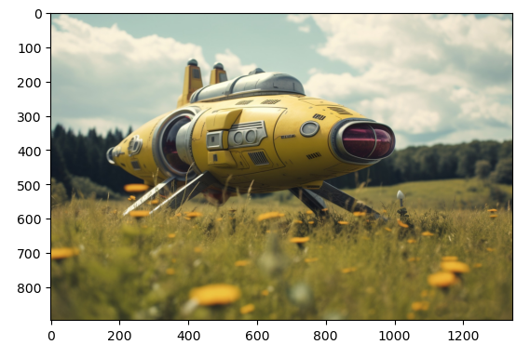
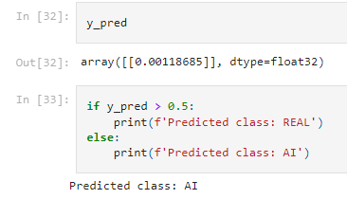
How Well Does It Generalize?

Slide 16
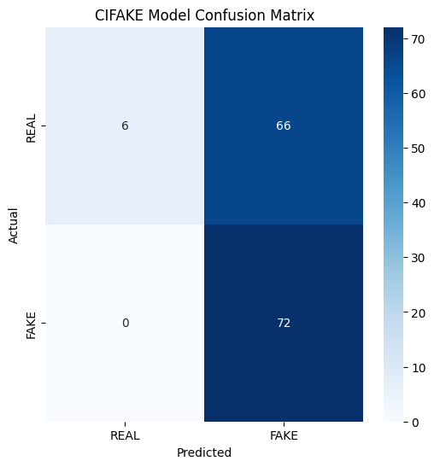
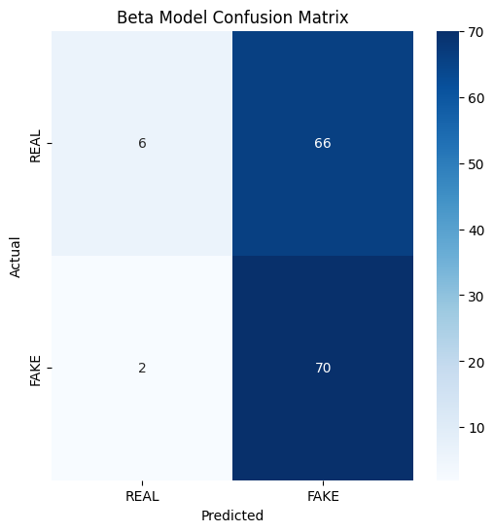

Out of Distribution Data Test – Pt. I
Metric | Value
Accuracy | 0.5417
Recall | 0.0833
Precision | 1.0000
Metric | Value
Accuracy | 0.5278
Recall | 0.0833
Precision | 0.7500
Metric | Value
Accuracy | 0.5347
Recall | 0.1111
Precision | 0.7273

Slide 17
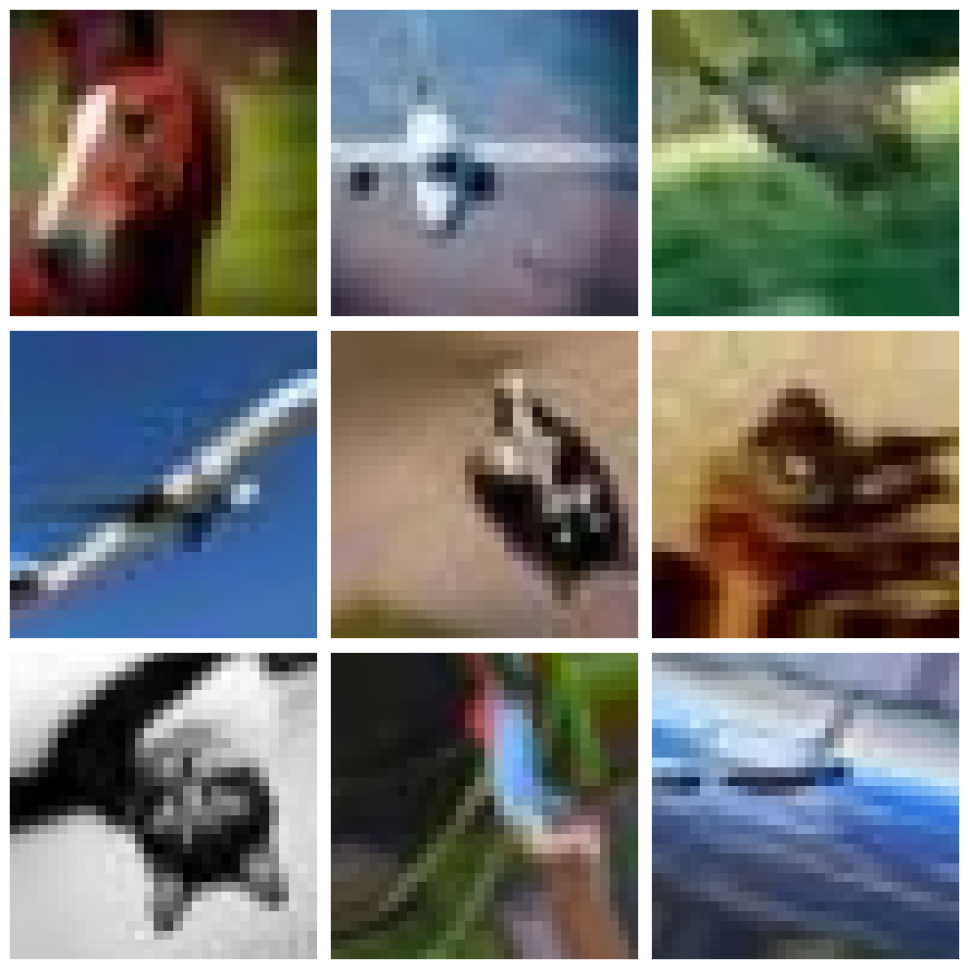
Image Augmentation
Randomly:
- Rotation up to 30 degrees
- Shear 20%
- Zoom 20%
- Horizontal/Vertical Flip

Slide 18
Best Model Comparison – Pt. II
Metric | CIFAKE Paper | Alpha | Beta | Gamma | Delta | Epsilon | Zeta
Accuracy | 0.9298 | 0.9312 | 0.9420 | 0.9484 | 0.8712 | 0.9044 | 0.8099
Loss | 0.1800 | 0.1947 | 0.1935 | 0.1466 | 0.3755 | 0.3060 | 0.7922

Slide 19
Out of Distribution Data Test – Pt. II
Novel Subjects
Metric | CIFAKE | Beta | Gamma | Delta | Epsilon | Zeta
Accuracy | 0.5417 | 0.5278 | 0.5347 | 0.5139 | 0.5208 | 0.5134
Recall | 0.0833 | 0.0833 | 0.1111 | 0.0556 | 0.06944 | 0.0278
Precision | 1.0000 | 0.7500 | 0.7273 | 0.6667 | 0.7143 | 1.0000
Familiar Subjects
Metric | CIFAKE | Beta | Gamma | Delta | Epsilon | Zeta
Accuracy | 0.5125 | 0.5500 | 0.5125 | 0.5375 | 0.5125 | 0.5125
Recall | 0.0250 | 0.1250 | 0.1250 | 0.0750 | 0.0250 | 0.0250
Precision | 1.0000 | 0.8333 | 0.5556 | 1.0000 | 1.000 | 1.000

Slide 20
Final Reflections
- Models appeared to learn what was “real” by memorizing the class label in the training data, and images that didn’t match those patterns were predicted as fake
- Performant AI detection systems will need a large sample of generated content across models and styles to mitigate sampling bias
- Training data will need to be consistently updated to keep pace with changing technology
- Watermarks or other signatures may simplify detection and remove the onus from ML solutions

Slide 21
Appendix

Slide 22
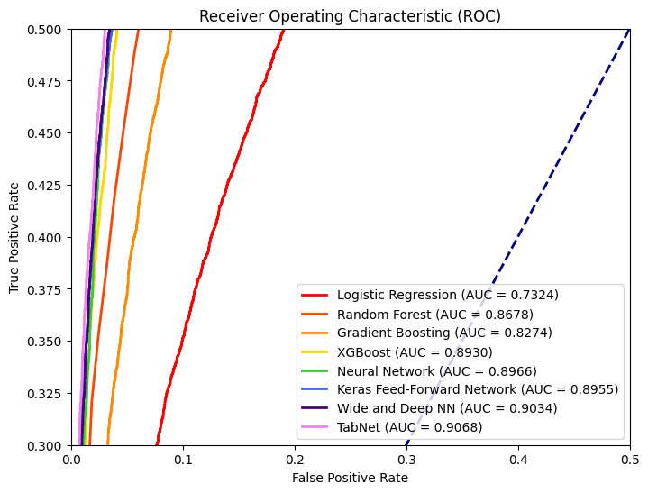
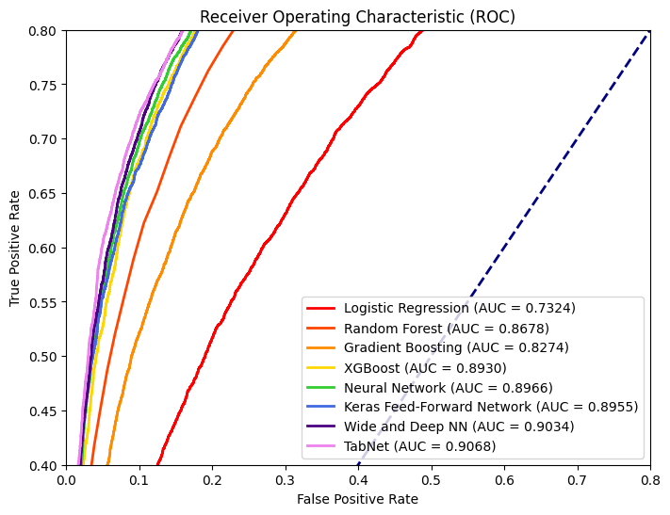
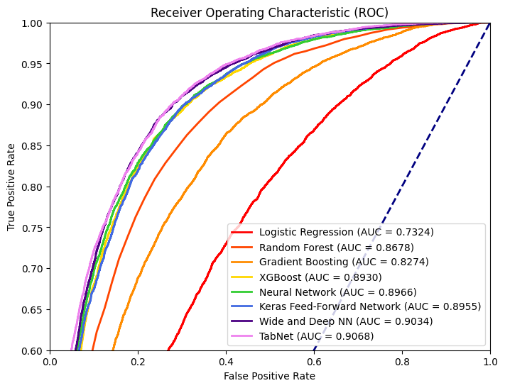
ROC Details

Slide 23
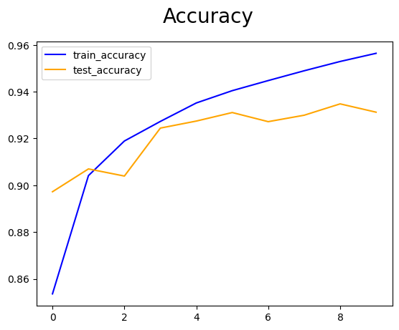
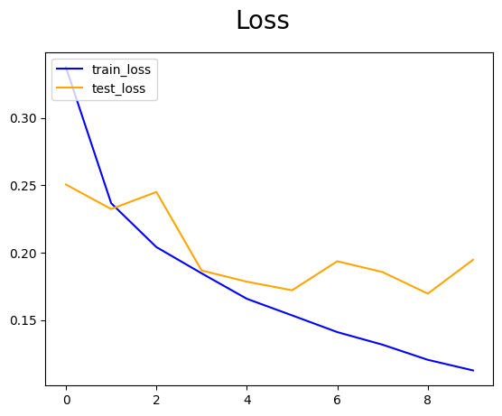
Alpha Performance Report
Epoch | Loss | Accuracy
1 | 0.2506 | 0.8972
2 | 0.2324 | 0.9070
3 | 0.2450 | 0.9039
4 | 0.1868 | 0.9244
5 | 0.1784 | 0.9275
6 | 0.1721 | 0.9311
7 | 0.1936 | 0.9272
8 | 0.1856 | 0.9299
9 | 0.1696 | 0.9348
10 | 0.1947 | 0.9312

Slide 24
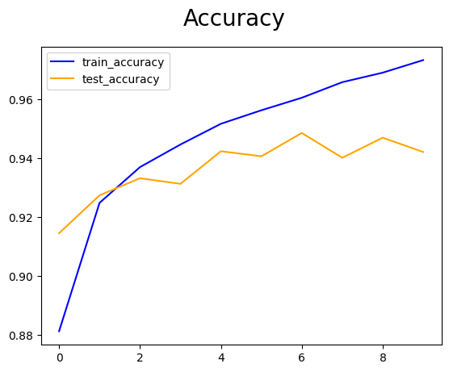
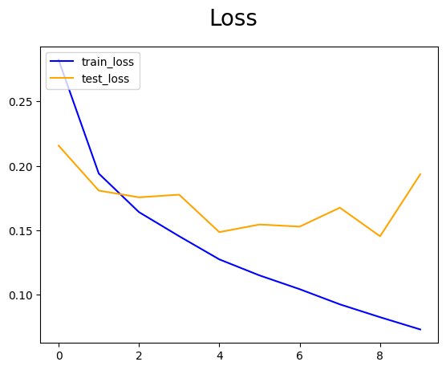
Beta Performance Report
Epoch | Loss | Accuracy
1 | 0.2158 | 0.9145
2 | 0.1809 | 0.9273
3 | 0.1756 | 0.9331
4 | 0.1777 | 0.9312
5 | 0.1486 | 0.9423
6 | 0.1545 | 0.9406
7 | 0.1529 | 0.9485
8 | 0.1676 | 0.9401
9 | 0.1454 | 0.9469
10 | 0.1935 | 0.9420

Slide 25
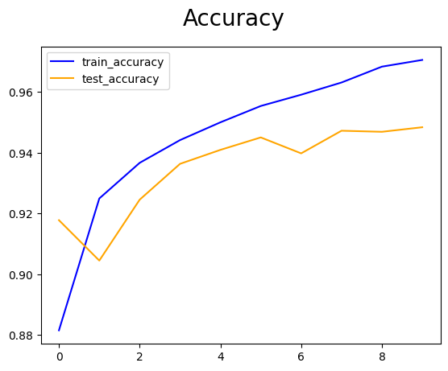
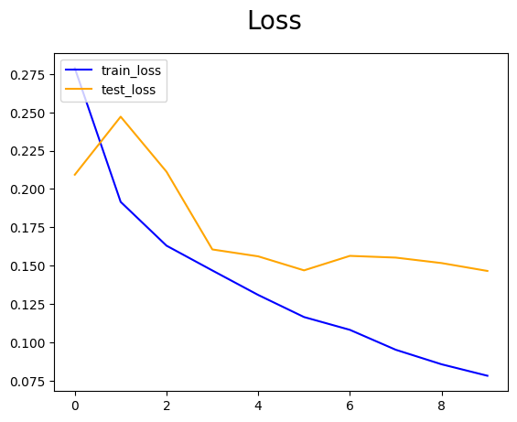
Gamma Performance Report
Epoch | Loss | Accuracy
1 | 0.2093 | 0.9178
2 | 0.2472 | 0.9045
3 | 0.2113 | 0.9245
4 | 0.1606 | 0.9363
5 | 0.1561 | 0.9409
6 | 0.1470 | 0.9451
7 | 0.1564 | 0.9398
8 | 0.1553 | 0.9473
9 | 0.1517 | 0.9469
10 | 0.1466 | 0.9484

Slide 26
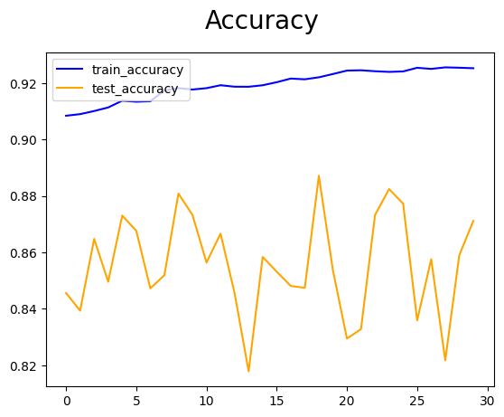
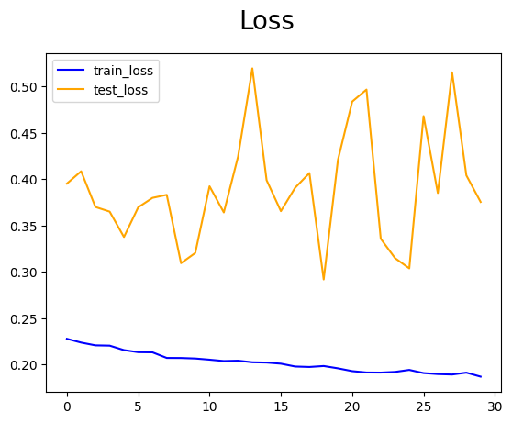
Delta Performance Report
Epoch | Loss | Accuracy
21 | 0.4838 | 0.8295
22 | 0.4968 | 0.8328
23 | 0.3358 | 0.8733
24 | 0.3149 | 0.8824
25 | 0.3038 | 0.8773
26 | 0.4682 | 0.8359
27 | 0.3851 | 0.8576
28 | 0.5155 | 0.8217
29 | 0.4042 | 0.8590
30 | 0.3755 | 0.8712

Slide 27
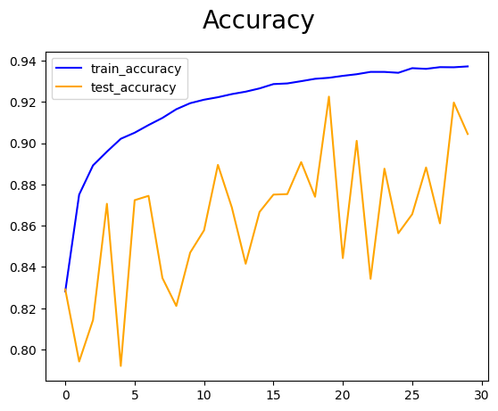
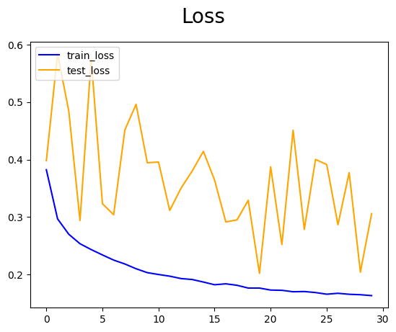
Epsilon Performance Report
Epoch | Loss | Accuracy
21 | 0.3874 | 0.8443
22 | 0.2524 | 0.9011
23 | 0.4509 | 0.8342
24 | 0.2787 | 0.8876
25 | 0.4002 | 0.8564
26 | 0.3913 | 0.8655
27 | 0.2867 | 0.8882
28 | 0.3773 | 0.8611
29 | 0.2044 | 0.9197
30 | 0.3060 | 0.9044

Slide 28
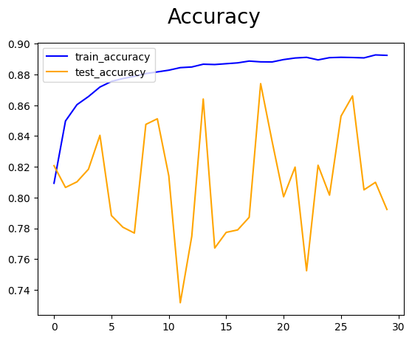
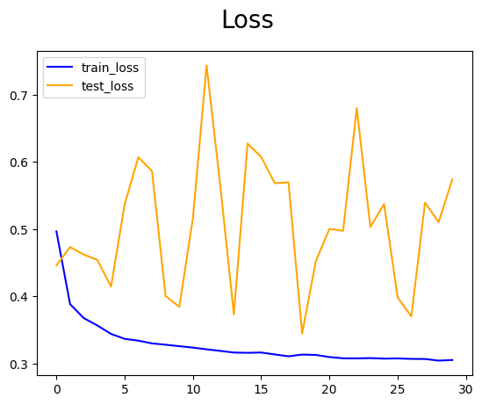
Zeta Performance Report
Epoch | Loss | Accuracy
1 | 0.5005 | 0.8005
2 | 0.4976 | 0.8198
3 | 0.6799 | 0.7524
4 | 0.5031 | 0.8210
5 | 0.5374 | 0.8015
6 | 0.3985 | 0.8529
7 | 0.3704 | 0.8661
8 | 0.5393 | 0.8050
9 | 0.5105 | 0.8099
10 | 0.5740 | 0.7922

Slide 29
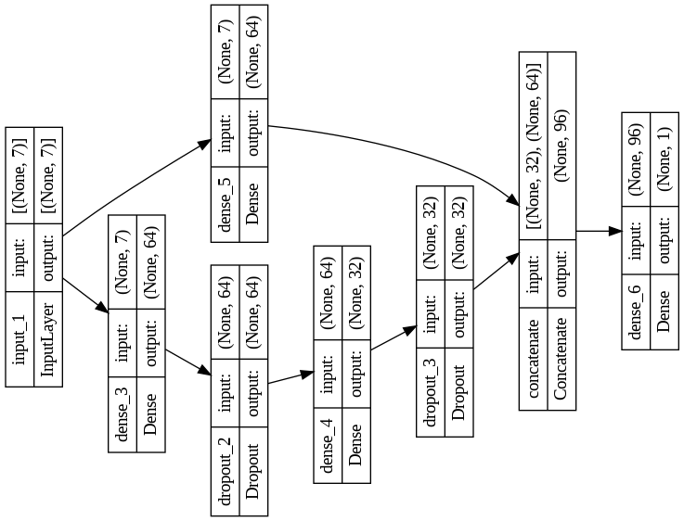
Wide & Deep Neural Network

Slide 30

Alpha/Delta Architecture

Slide 31
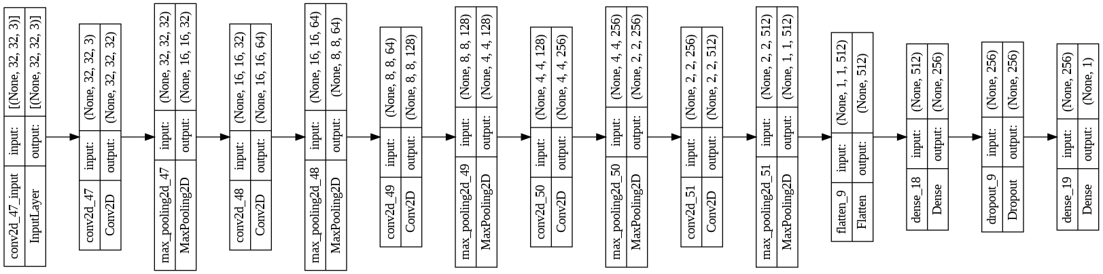
Beta/Epsilon Architecture

Slide 32
Gamma/Zeta Architecture

